Slide 1


NURTURA-AI
Smart Companion for Pregnancy & Women’s Wellness
TAGLINE-
AI-powered care, comfort, and confidence for every mother.
TEAM NAME-TECHTOK
TEAM MEMBERS- ANJALI SRIVASTAVA AND
SUNDRAM KUMAR TIWARI
RAJEEV KUMAR KAUSHIK
THEME-HEALTHTECH

Slide 2


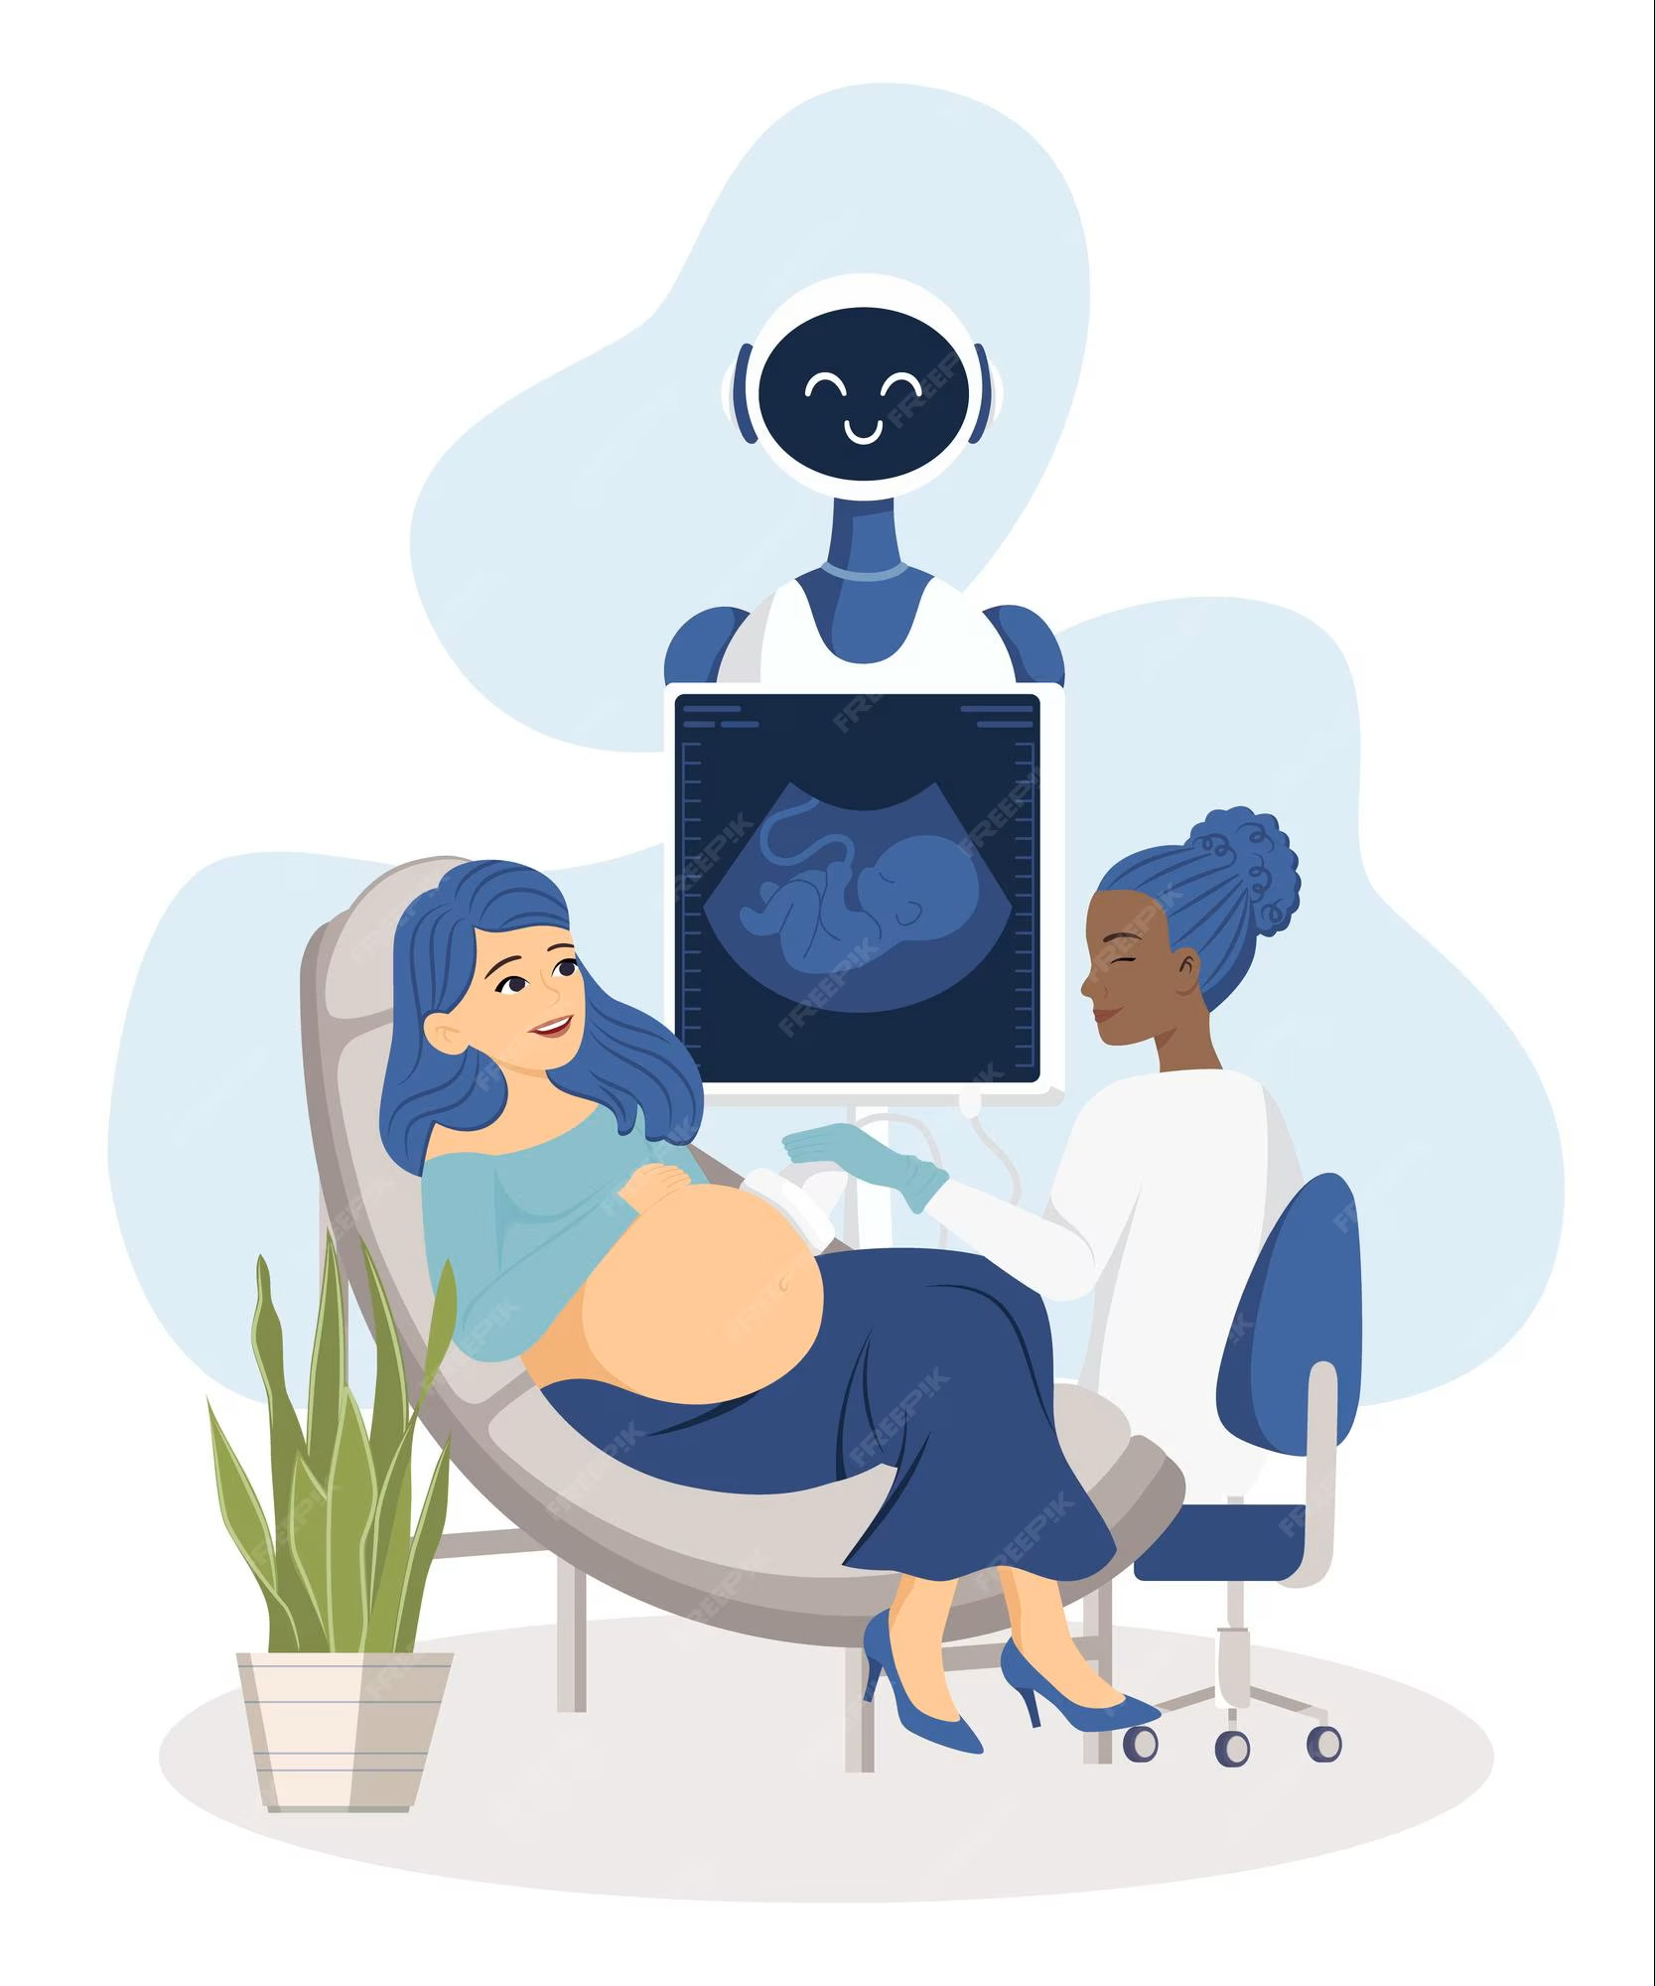


PROBLEM STATEMENT-
Pregnant women in India often face challenges in accessing reliable, personalized, and timely information about pregnancy, childcare, and maternal health, leading to anxiety, misinformation, and suboptimal health outcomes. Existing solutions are fragmented, and there's a need for a comprehensive, AI-driven platform that empowers expectant mothers with accurate guidance, support, and resources throughout their pregnancy journey.
This leads to:
Increased anxiety and misinformation,
Missed prenatal checkups or medication schedules,
Lack of emotional and mental health support, and
Difficulty tracking baby growth and health indicators.

Slide 3
💡 Solution – Nurtura AI: Your Smart Pregnancy Companion
Nurtura AI is an AI-powered pregnancy and wellness assistant that provides personalized guidance, emotional support, and health tracking to expecting mothers — anytime, anywhere.
🌷 Key Features:
🤖 AI Chatbot for Pregnancy Support:
Offers daily tips, answers health queries, and provides week-by-week pregnancy guidance.
❤️ Emotional Wellness & Mental Check-ins:
Detects mood through chat tone and offers mindfulness exercises or encouragement.
⏰ Smart Reminders:
Notifies about medicines, hydration, nutrition, and doctor appointments.
🌍 Inclusive & Multilingual Design:
Supports multiple Indian languages for wider accessibility.
🩺 Data Insights & Health Tracking:
Tracks vitals and symptoms, integrating with wearables or manual inputs.
✨ How It Works:
User logs in and shares pregnancy stage.
AI personalizes insights and daily care tips.
Continuous feedback loop improves recommendations and emotional support.

Slide 4
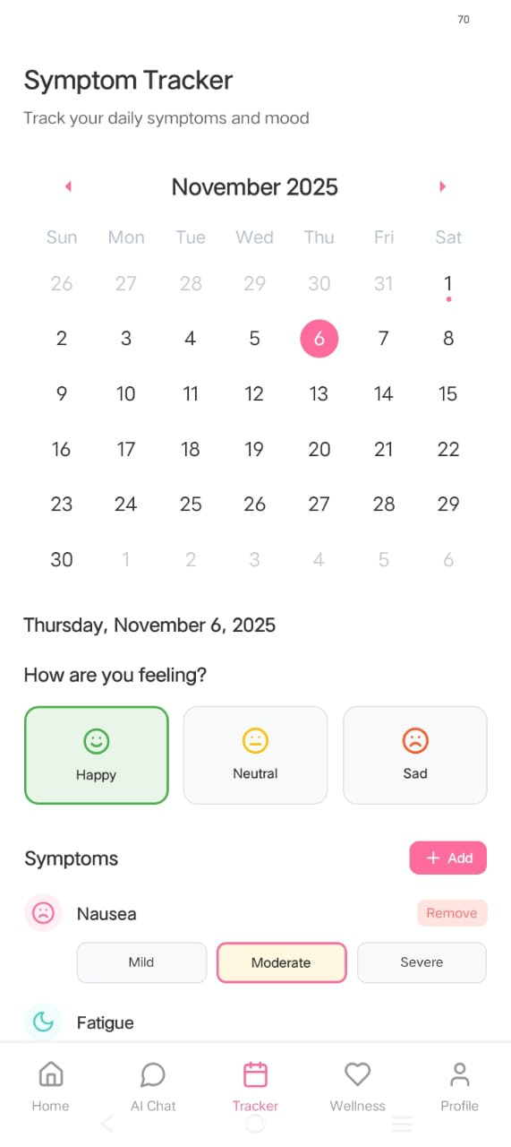
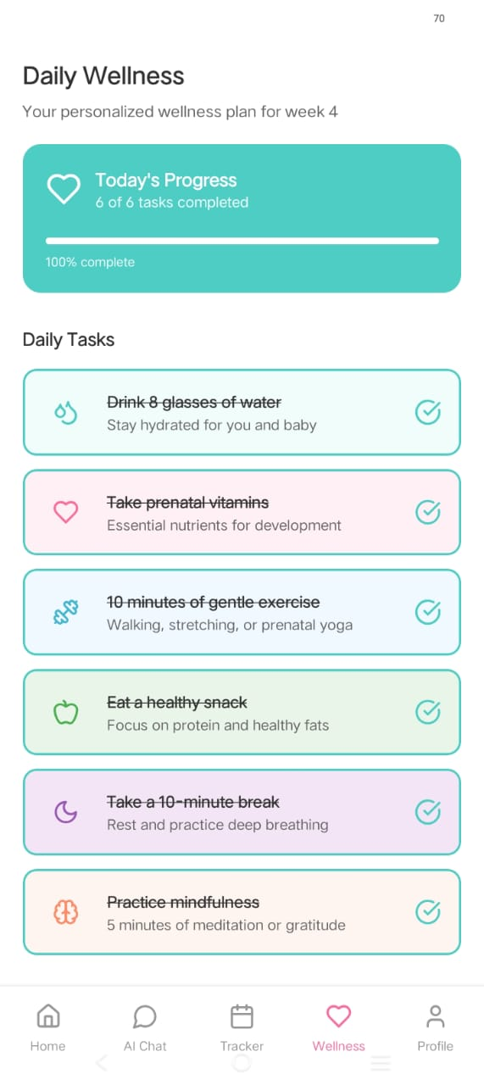

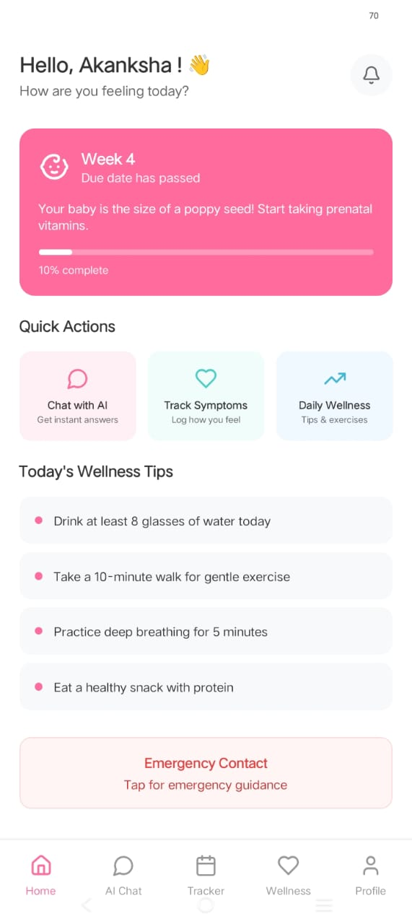
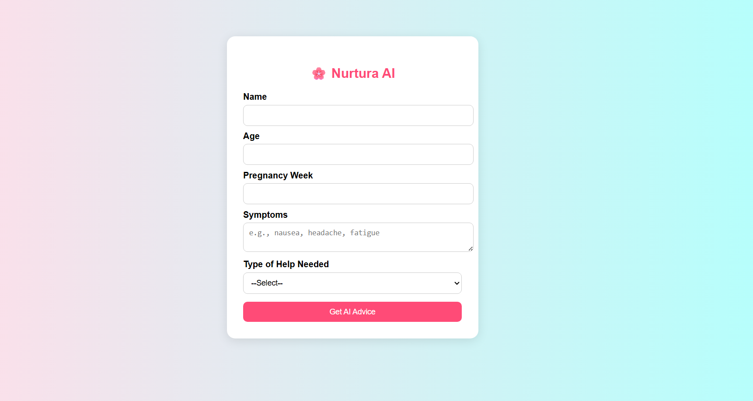
NURTURA AI

Slide 5
🌱 Impact & Future Vision – Nurtura AI
💖 Impact
🌸 Empowering Expectant Mothers:
Provides personalized, AI-driven guidance to help women feel supported, confident, and cared for.
🩺 Improved Maternal Health Awareness:
Encourages timely checkups, better nutrition, and emotional stability.
🌍 Bridging the Healthcare Gap:
Brings digital pregnancy support to rural and underserved communities with multilingual and offline access.
🧠 Data-Driven Insights:
Aggregated (anonymous) data can help improve maternal health policies and care systems.
🚀 Future Vision
Phase 1: MVP – AI chatbot for pregnancy tips, reminders & emotional wellness
Phase 2: Integration with doctors and wearable devices
Phase 3: Expansion into full Women’s Wellness Ecosystem (postnatal care, mental health, child growth tracking)
Long-Term Goal: Make Nurtura AI the trusted digital companion for women’s health globally 🌏

Slide 6
⚙️ Technology & Uniqueness – Nurtura AI
🧠 Tech Stack Overview
Frontend: Flutter (cross-platform app for Android & iOS)
Backend: Firebase (authentication, real-time data, notifications)
AI Engine: OpenAI / Google Vertex AI for personalized pregnancy guidance
Database: Firestore for storing user data securely
Optional Integration: Smartwatch or wearable data for health tracking
💎 What Makes Nurtura AI Unique
🌸 Personalized for the Indian Context
Tailored guidance based on regional languages, diet, and lifestyle.
❤️ Emotional + Medical Wellness Fusion
Unlike typical pregnancy apps, Nurtura AI supports both physical and emotional wellbeing.
🗣️ Voice and Chat-Based Interface
Accessible for women with limited literacy — users can speak naturally in their language.
📶 Offline Accessibility Mode
Allows continued use even with limited internet connectivity.
🔒 Privacy First Design
Secure, encrypted user data storage and ethical AI use.

Slide 7
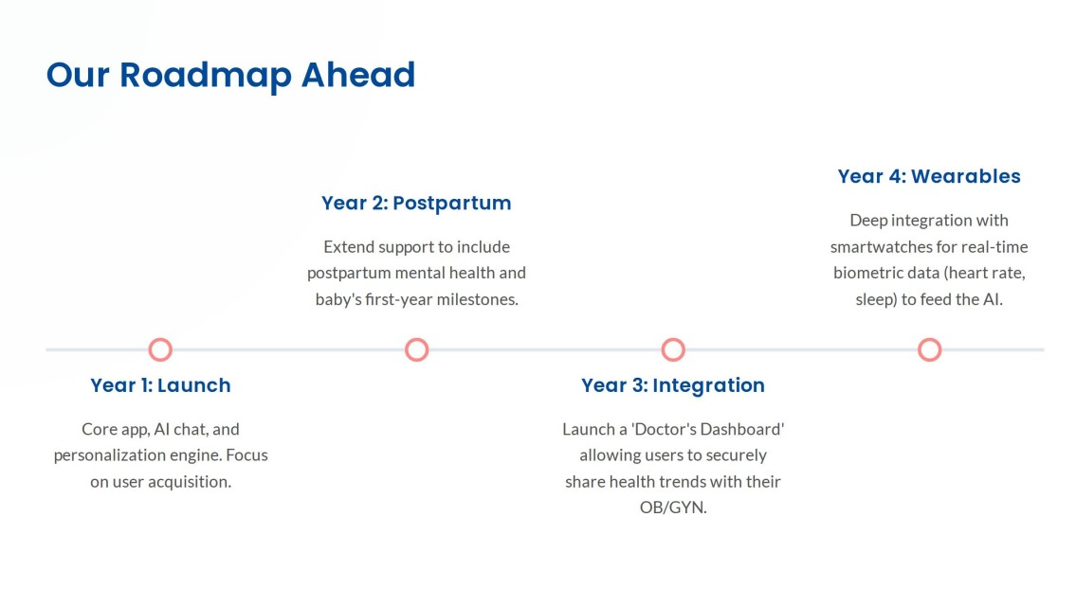

Slide 8
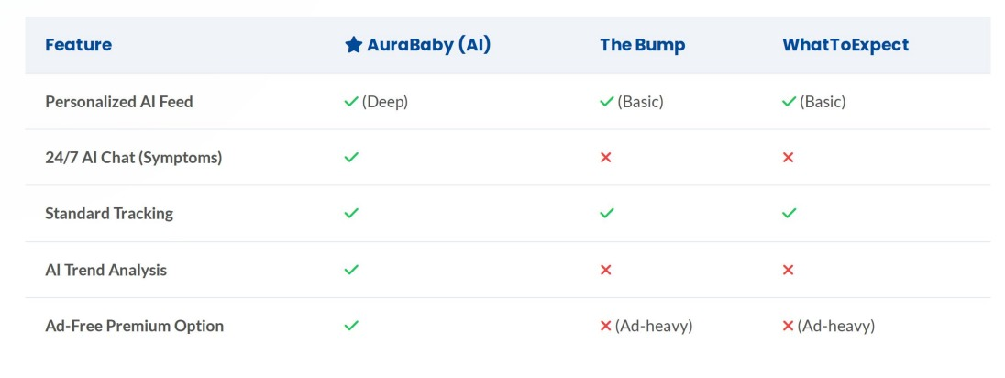

Slide 9
🎯 Target Audience of Nurtura AI
Nurtura AI is designed for pregnant women in India (ages 20–40) who seek personalized, AI-based guidance during pregnancy. It especially targets first-time mothers in urban and semi-urban areas who want local-language support, culturally relevant nutrition advice, emotional care, and trustworthy medical insights.
Secondary audience: partners, postpartum mothers, and healthcare providers recommending digital pregnancy support tools.
✅ Why This Audience Makes Sense for Nurtura AI
According to market data, the India prenatal & postpartum app market is growing rapidly — e.g., India’s pregnancy tracking & postpartum care apps market expected to grow at ~19.9 % CAGR from 2024-2030. Grand View Research+1
Millennials & Gen Z women are more likely to adopt digital health solutions. FasterCapital+1
By focusing on personalisation + regional/localisation + AI-driven insights, you tap into a niche where many existing apps are weaker.
A well-defined target audience helps you design features, pick UX, marketing messaging clearly (for example “for Indian expecting mums who want personalised, culturally relevant pregnancy support”).

